Slide 1
PREDICTING SHOCK OUTCOME BY HUMAN VENTRICULAR FIBRILLATION ANALYSIS USING KNOWLEDGE DISCOVERY TECHNIQUES
Sharad Shandilya
Nazanin Mirshahi
Venkat Chennu

Slide 2
INTRODUCTION
Ventricular Arrhythmias (too fast/slow/irregular heart rhythms originating from the Ventricle), most commonly result in:
  Sudden cardiac arrest
  Myocardial Infarction (Heart Attack)
  **Immediate medical attention including resuscitation and defibrillation is needed**

Slide 3
SIGNIFICANCE
Timely defibrillation is essential for return of spontaneous circulation (ROSC)
Chances of survival decrease by 5-10% for every minute that passes by.
Most shocks delivered are unsuccessful.
Real time, short-term analysis of ECG
  Understand the problem and assess the current state
  Predict future states
  Take necessary action

Slide 4
CONJECTURE
Is there something inherent in the ECG signal that can help us make defibrillation more effective? If so, how can we best utilize such data?

Slide 5
MINIMIZE INAPPROPRIATE AND MAXIMIZE NO. OF APPROPRIATE SHOCKS
Each “appropriate” shock should lead to ROSC(Return of Spontaneous Circulation)
Each “inappropriate” shock causes electrical damage to heart tissue, in addition to adding to the time lost.

Slide 6
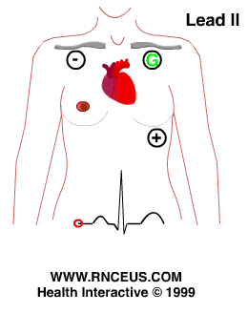
DATASET
Lead II:
  Best illustrates the alterations in level and direction of shocks after cardiac arrest
  The voltage difference between the right arm electrode and the left leg one
  The most common monitoring lead among the 12 ECG leads
The placement of lead II in human body

Slide 7
DATASET (CONT’D)
  Contains 77 cardiac arrest cases with multiple shocks
  Additional data samples will be acquired, contingent upon IRB approval, from the Medical College of Virginia.
  Sampling rate of 250Hz

Slide 8
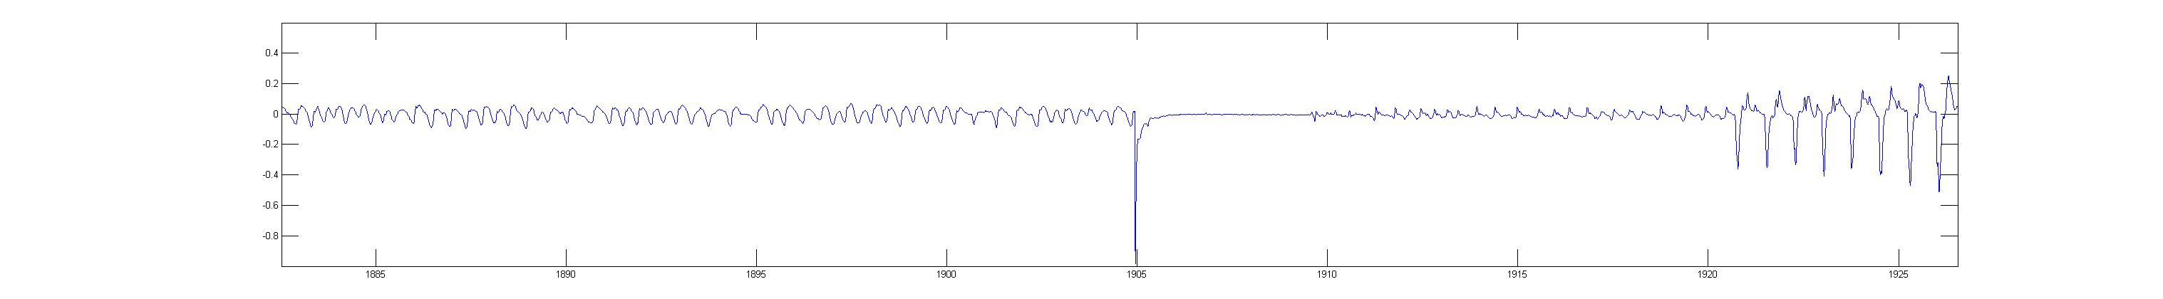
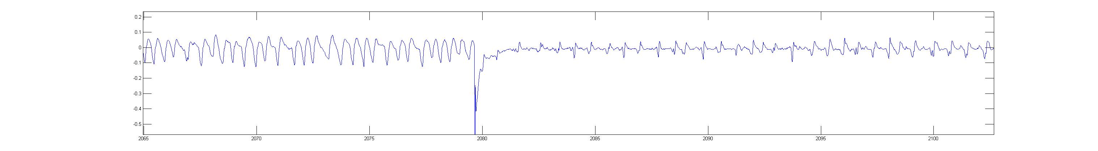
UNSUPERVISED DATA TO SUPERVISED DATA

Slide 9
PRE-PROCESSING
MATLAB®, Weka®
Objective:
  Remove high frequency noise
  Remove baseline drift (slow)
  Remove sudden jumps (fast)

Slide 10
PRE-PROCESSING (CONT’)
Technique utilizes Savitzky-Golay low-pass (smoothing) filter,
  Step 1: Fit a moving window, of width ‘k’ data points, to a p <= k-1 degree polynomial by the least-squares method
  Step 2: Resulting signal is successively ‘smoothed’ (again using S-Golay) until only the jumps and drifts remain.
  Step 3: Result of step 1 – Result of step 2 = Cleaned Signal

Slide 11
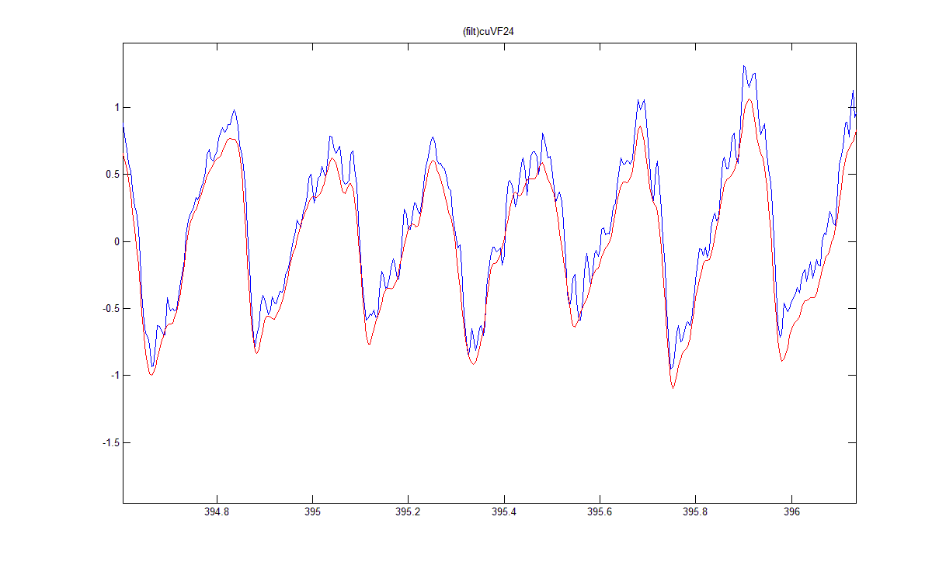
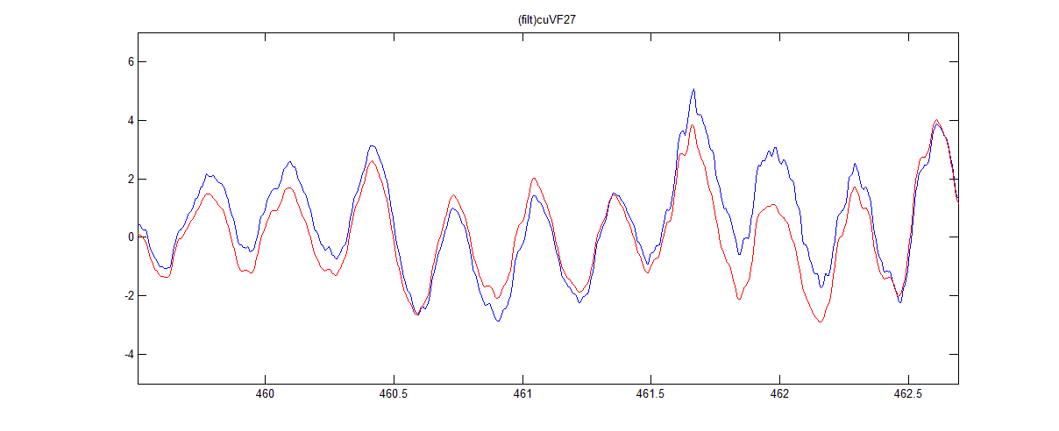
PRE-PROCESSING RESULTS

Slide 12
NEXT STEP
Feature extraction:
  Fourier transform
  Wavelet transform
  Original time-series
  ...

